Slide 1
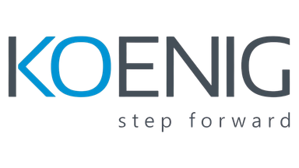



Date: 12 Mar 2026 | Audience: Training Team | Owner: Aishwar
HUDDLE MEET
Skill
Sync
“Align on mock outcomes, confirm April plan, lock exam + webinar dates, and agree governance cadence.”
Notes:
Let me begin with a simple question. When a trainer walks into a classroom, how long do you think it takes for the audience to decide whether the trainer actually knows the subject? (pause) Not an hour… not even fifteen minutes… usually within the first five minutes the room already knows. The confidence, the explanation flow, the way the trainer connects ideas — all of that becomes visible very quickly. And that’s exactly why we are here today. This huddle is not about reviewing slides or filling reports; this is about making sure our delivery as a team becomes predictable and confident. Over the last few weeks we’ve been stabilizing mocks, improving explanations, tightening preparation. Now the next step is moving into consistent execution. So today we align on mock outcomes, confirm the April roadmap, lock certification and webinar timelines, and agree on governance cadence. Think of this like a pit stop in a racing strategy — quick alignment, tighten the bolts, and then we accelerate again. Are you with me?

Slide 2







01
Latest Mocks (10 min) → Decision: gating & re‑mock dates
02
Communication & Delivery (10 min) → Decision: rubric + cadence
03
Certification & Webinar Governance (10 min) → Decision: exam dates + 2 topics each
04
April Roadmap (20 min) → Decision: weekly milestones, owners
05
Next Steps (10 min) → Decision: dashboard format, review slot
Notes:
Imagine starting a meeting without knowing what decisions need to come out of it. The conversation may feel productive, but when it ends everyone still wonders what exactly they should do next. That’s why the flow of this huddle is very intentional. We begin by reviewing latest mock outcomes, because that tells us where delivery readiness actually stands today. Then we look at next steps and tracking, so progress becomes measurable instead of vague. After that we discuss communication and delivery discipline, because strong knowledge can still fail if explanations are unclear. From there we move to the April roadmap, aligning milestones and ownership. And finally we lock certification and webinar governance, ensuring growth and visibility continue. The idea is simple — by the end of this meeting, nobody should leave wondering what their next action is. That clarity is the real outcome of this session.

Slide 3
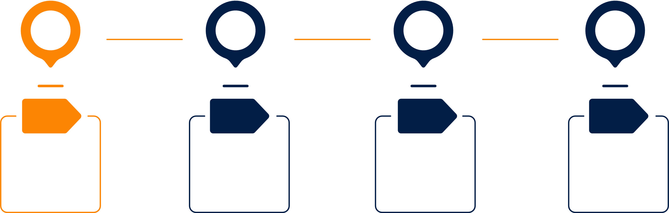


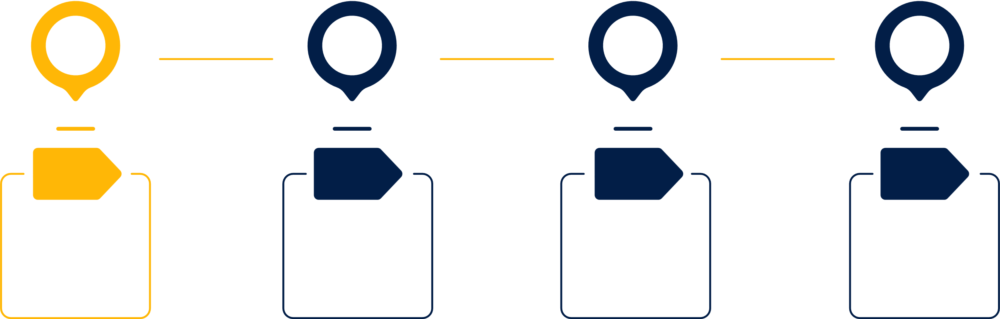

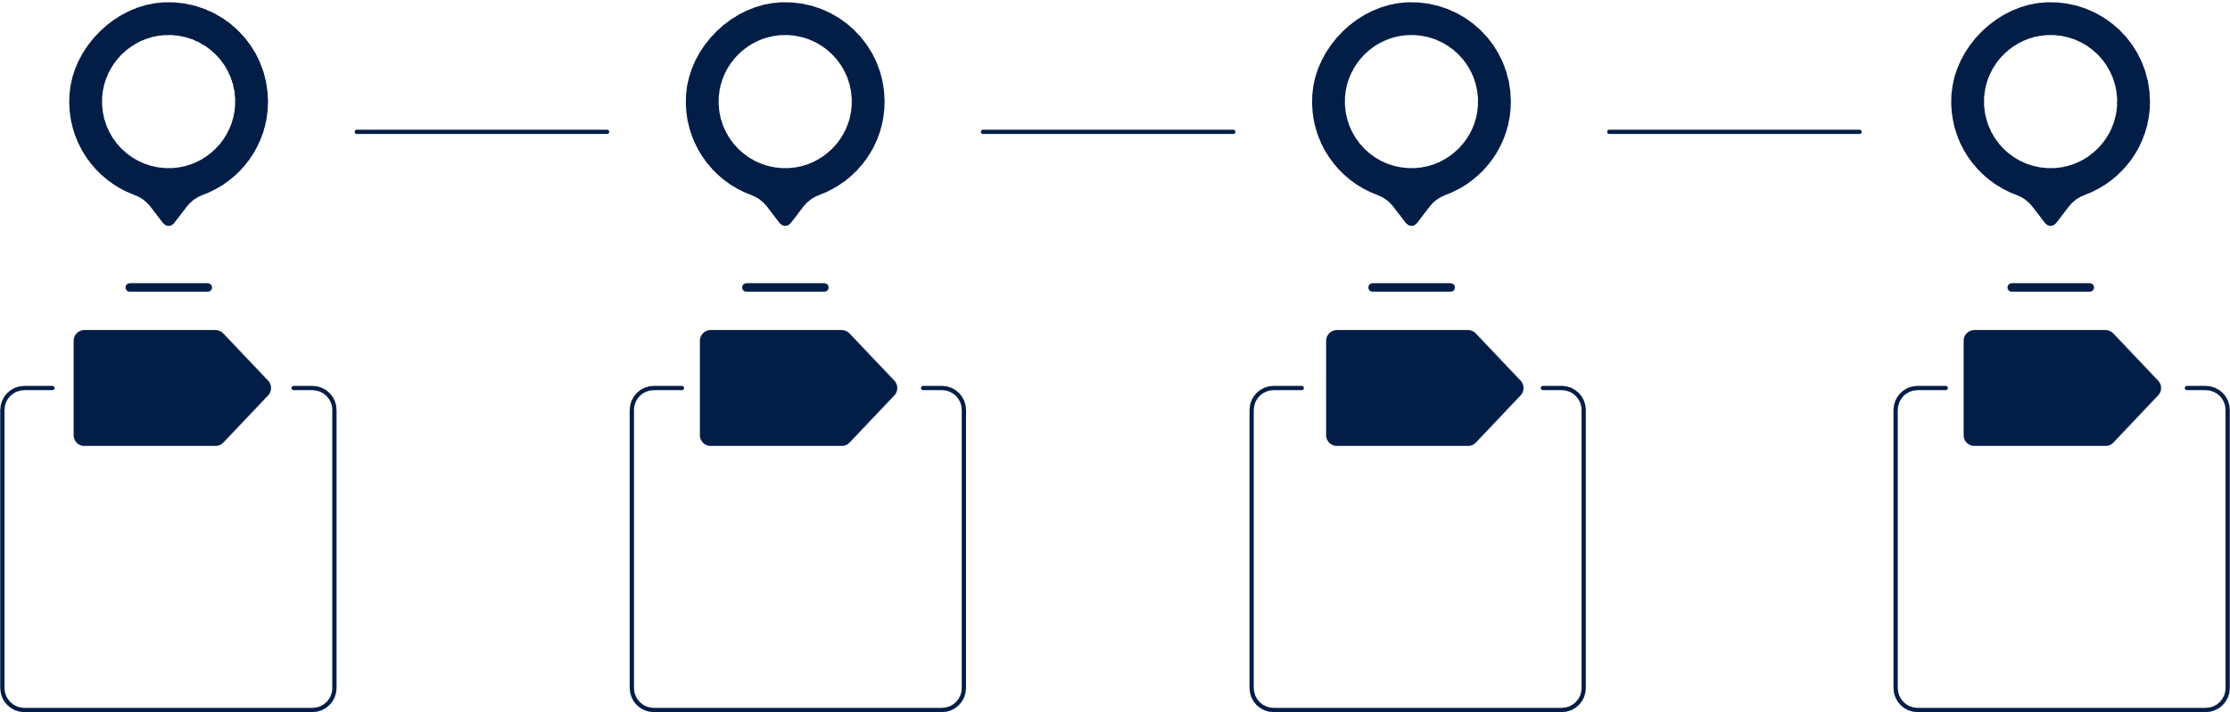


This huddle marks the shift from stabilization to consistent, predictable delivery—with stable mock outcomes, disciplined communication, and visible execution standards.
MEETING THEMES
Key improvements observed since February
Areas where delivery stability still fluctuates
Insights from mock sessions and recurring performance patterns
Priority focus areas for the next 30 days
Reduce filler words and strengthen concept definitions
Maintain clear delivery flow: Opening → Body → Closure
Use bridge lines to transition smoothly between topics
Ensure calm pacing and confident narration during window or demo transitions
Transition to Predictable Delivery
Readiness & Performance
Communication Maturity
Notes:
Let’s step back for a moment and look at the bigger picture. Over the last month our team has been in what I call the stabilization phase. Mocks were happening, communication patterns were being observed, explanations were being corrected. But stabilization alone is not the goal. The real goal is predictable delivery. Predictable delivery means when a trainer from our team walks into any classroom, the session feels structured, calm, and professional. The opening makes sense, the explanation flows logically, the demo connects to the concept, and the recap closes the loop. That kind of delivery does not happen randomly; it happens when the team focuses on three things: stable mock outcomes, disciplined communication, and visible execution standards. Over the next thirty days those three pillars will define our improvement focus.

Slide 4

LATEST
MOCKS
Structured block: slides below are scoped only to this section.
Notes:
Let me ask something practical. Why do we conduct mock sessions at all? Not because we doubt someone’s knowledge. Mocks exist because delivery problems are much easier to fix before the real classroom happens. They act like an early warning system. A mock reveals where explanations become unclear, where transitions break, where pacing becomes uneven. And the earlier we detect those signals, the easier it is to correct them. So when we review mock outcomes today, the intention is not criticism. The intention is course correction while improvement is still easy.

Slide 5


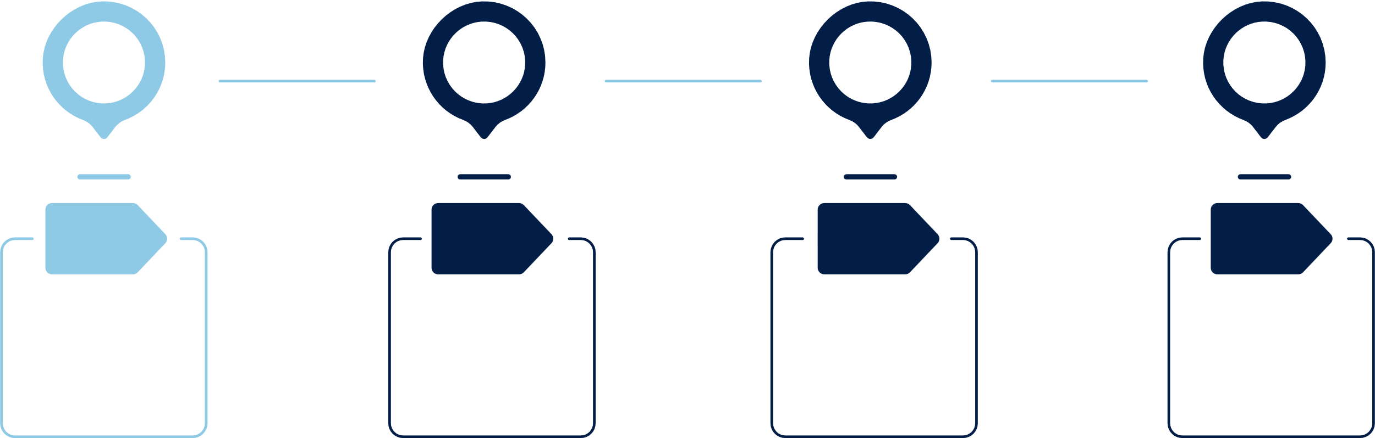


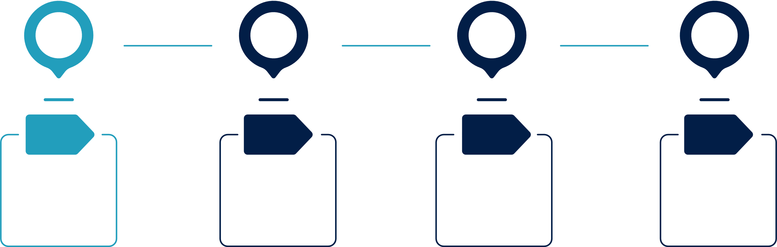



SUMMARY — ABHINAV (DP‑700)
Stamp: “Mock date: 11 Mar 2026, 11:46 AM | Course: DP‑700 (Fabric) | Decision: Not Ready”
Gating criteria
Implement Changes
≥90% readiness before delivery.
Definitions ≤15 sec. Use bridge transitions.
Lab narration: Goal → Steps → Verify → Next.
Reduce fillers and tighten definitions.
Use trainer bridge lines between topics.
Analyze Input
Strengths: coachable, Fabric basics clear.
Improve delivery clarity and remove fillers.
Retest Result
Re-mock within 7–10 days.
Mini-lab: workspace → lakehouse → OneLake → Spark + SQL validation.
Prioritize Fixes
Practice definitions daily.
Add industry examples.
Prepare demo environment.
Notes:
Let’s start with Abhinav’s mock. One thing that stood out positively was that the Fabric fundamentals were conceptually clear. That is a good sign, because architecture topics can easily become confusing if the mental model is not solid. Another positive indicator was coachability — the ability to absorb feedback and adjust explanations quickly. But we also identified a few areas where delivery must become sharper. Definitions need to become short, precise, and confident, ideally landing within fifteen seconds. Another improvement area is the use of bridge transitions — those small lines that connect one idea to the next so the audience never feels lost. And during labs the narration must follow a clean structure: Goal → Steps → Verify → Next. That loop keeps the audience aligned with the purpose of the demonstration instead of just watching clicks. The decision here is straightforward: focused practice and a re-mock within the next week.

Slide 6
SUMMARY — NIHARIKA (DP-900)
Mock Review | Course: DP-900 | Focus: Delivery readiness and terminology accuracy
Gating Criteria
Define terms clearly: Entity / Attribute, ACID, ETL.
Use correct terminology while explaining fundamentals.
Implement Changes
Adjust design or function based on real user needs.
Analyze Input
Strengths: calm delivery tone, good use of annotations.
Improve conceptual accuracy and definition precision.
Retest Result
Check if updates improve user experience.
Prioritize Fixes
Avoid slide reading.
Use trainer buy‑time lines.
Keep explanations concise and structured.
Notes:
Now let’s talk about Niharika’s mock. Since she is early in the team journey, the evaluation lens is slightly different. What we observed positively was a calm delivery tone and good use of slide annotations, which actually indicates strong presentation instincts. However, fundamentals training depends heavily on definition accuracy. Terms like Entity, Attribute, ACID, and ETL must be explained with absolute clarity. When these definitions are crisp, the rest of the explanation naturally becomes easier for the audience to follow. Another improvement area is avoiding slide reading. Slides should support the explanation, not replace it. And one useful habit every trainer should develop is the use of buy-time lines — those short phrases that give the brain a moment to organize the explanation. With consistent practice, these small adjustments will make the delivery much more structured.

Slide 7





Team Questions
Ask your question?
Doubts
Notes:
Let me pause here for a moment. Whenever we review mock feedback, it’s important that everyone understands not just what needs improvement, but also why it matters for delivery quality. So if something in the feedback feels unclear, this is the right time to ask. Are there any questions about the mock observations before we move forward?

Slide 8

Certification & Webinar Governance
Structured block: slides below are scoped only to this section.
Notes:
Now that we have looked at readiness signals, the next step is understanding how we strengthen delivery discipline across the team. Technical knowledge alone does not guarantee a strong session. The real difference appears in how knowledge is structured and communicated. That’s why the next few slides focus on delivery frameworks — small practices that make sessions clearer, more engaging, and easier for the audience to follow.

Slide 9









Concept
“10‑5‑1” cadence: Concept (10 min) → Demo/Diagram (5 min) → Recap (1 min). Close the loop every time.
Q&A
Park during flow; resolve at checkpoints; summarize answers back to the room.
Delivery
Structure
10-5-1
topics
Use bridge lines to navigate (“We’ve closed the concept—now a quick diagram.”).
Keep the pace controlled; narrate intent and success markers (Goal → Steps → Verify → Next).
intentional
Notes:
Let me ask you something from your own experience. Have you ever attended a technical session where the trainer kept explaining concept after concept, and somewhere in the middle the audience slowly stopped following? That usually happens when explanations don’t have checkpoints. That’s why we follow the 10-5-1 delivery rhythm. Ten minutes to explain the concept clearly. Five minutes to reinforce it using a diagram, example, or demonstration. And then one minute to recap what the audience should remember. That final one minute is extremely powerful because it resets everyone’s understanding before the session moves forward. During explanations, questions should be parked temporarily and addressed at logical checkpoints so the flow of learning stays intact.

Slide 10





Voice & Slide Discipline
Voice Control
Definition Quality
Reduce fillers; use crisp window‑switch lines.
Short, clean definitions; avoid loops.
Slide Behavior
Pacing & Pauses
Speak from the slide; annotate key flow.
Calm tone under pressure; intentional pauses.
Notes:
Let’s talk about something subtle that separates average sessions from strong sessions — voice discipline. When trainers feel uncertain, the voice speeds up, filler words appear, and explanations become circular. But confident delivery follows a different rhythm. The voice stays calm, pauses appear naturally, and definitions land clearly. Slides should support the explanation, not control it. Instead of reading slides, the trainer should speak around the slide, expanding the idea in simple language while the slide acts as a visual anchor. Reducing fillers, tightening definitions, and maintaining clean transitions are small habits that dramatically improve delivery quality.

Slide 11




Lab Delivery Flow
Success Markers
Narrate with Intent
Call out verification explicitly—row counts, status, path validation, or logs.
Narrate actions at a concept level, not line‑by‑line instructions.
Environment Prep
State the Goal
Checkpoints Flow
Pre‑load environment, datasets, tabs, and credentials before starting the lab.
Explain the purpose of the lab in one clean sentence before executing any step.
Use Goal → Steps → Verify → Next to close the loop and show what this enables next.
Notes:
Now think about how most technical demos are usually delivered. The trainer starts clicking buttons and narrating steps. But the audience does not care about clicks; they care about what the action achieves. That’s why every lab demonstration must begin with a clear goal. Once the goal is clear, the steps make sense. After the steps we verify the outcome — row counts, status messages, logs, whatever confirms success. And finally we explain what that result enables next. This loop — Goal → Steps → Verify → Next — transforms a simple demo into a learning experience.

Slide 12
Team Questions
Ask your question?
Doubts
Notes:
Let me pause here for a moment. Delivery frameworks sound simple when we discuss them, but applying them consistently during a real session requires practice. If anything in the delivery structure feels unclear, this is the right time to raise it before we move into the governance section.

Slide 13

CERTIFICATION & WEBINAR
GOVERNANCE
Notes:
So far we have discussed how sessions should be delivered. Now the next question becomes: how do we ensure the team keeps improving over time? That requires governance. Governance is not about control; it is about creating a system that ensures learning, preparation, and execution keep moving forward without depending on reminders.

Slide 14



45-DAY CERTIFICATION GOVERNANCE
Readiness Gate
Must hit ≥90% readiness with mock sign‑off before live
Lock & Review
Lock exam date early; run weekly prep reviews
45‑Day Cycle
One certification every 45 days; rolling schedule.
Notes:
Let me ask something directly. Why do certifications matter for trainers? Not because of the badge. Certifications force us to revisit concepts, update our knowledge, and close gaps we might not notice during normal preparation. That is why we follow a 45-day certification cycle. Each trainer targets one certification within that period. The exam date should be locked early, preparation must be reviewed weekly, and readiness must cross ninety percent before any delivery responsibility is assigned.

Slide 15









WEBINAR DISCIPLINE FRAMEWORK
Minimum 2 webinars per trainer per month
Rehearsal checklist; reflection notes post-session
Visibility, interaction maturity, classroom authority
Audience-focused slides and flow
Notes:
Certifications strengthen knowledge, but webinars strengthen communication authority. When you conduct webinars regularly, you learn how to handle audience questions, control pacing, and explain ideas clearly even under time pressure. That’s why each trainer should conduct two webinars every month. Slides must focus on audience value, rehearsals should happen before the session, and reflection notes should be written afterward so improvements become intentional.

Slide 16
Team Questions
Ask your question?
Doubts
Notes:
Before we move to the roadmap section, let me pause again. If there are any questions regarding certification timelines or webinar expectations, let’s address them now.

Slide 17
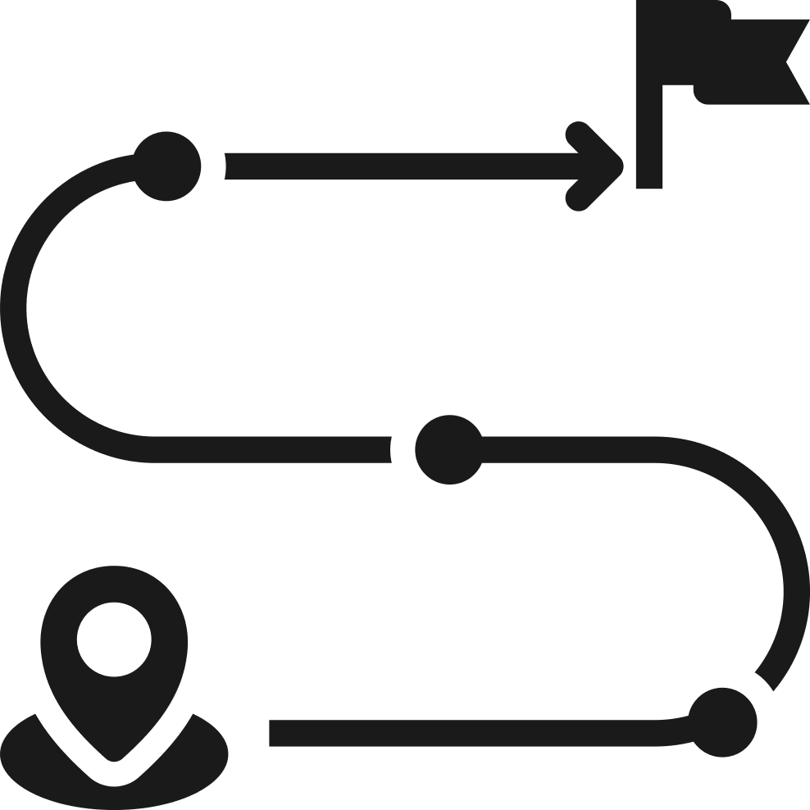
APRIL
ROADMAP
Notes:
Planning without milestones usually leads to confusion later. That’s why the next section focuses on the April roadmap, where we translate goals into clear execution checkpoints.

Slide 18
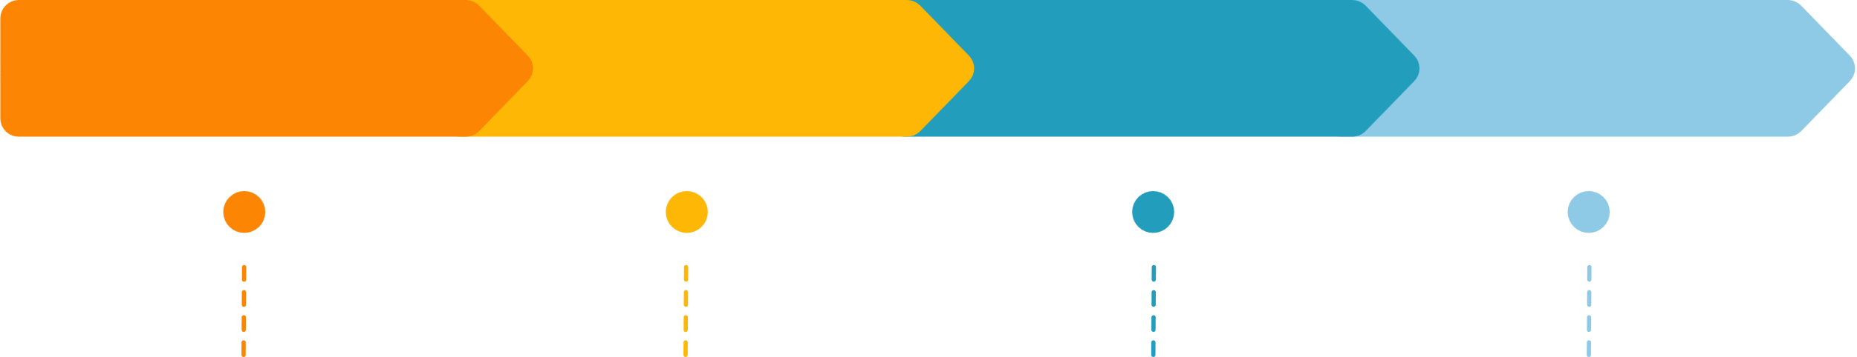





APRIL ROADMAP - ABHINAV
Plan Stage
Design Phase
Build Period
Launch Cycle
DP-700 completion
3 mocks (communication + architecture)
1 advanced delivery at >= 90% readiness
2 webinars
Notes:
For Abhinav, April is focused on strengthening Fabric readiness. The immediate milestone is completing DP-700 preparation. Alongside that there will be two webinars and three mock sessions focused on architecture explanations and communication clarity. Once the mock readiness crosses ninety percent, we schedule an advanced delivery session to confirm that the improvements are stable.

Slide 19
APRIL ROADMAP - NIHARIKA
Plan Stage
Design Phase
Build Period
Launch Cycle
DP-900 clearance
SQL foundation (30 days)
3 internal mocks
1 micro-webinar (10 min)
Notes:
For Niharika, the roadmap emphasizes strong foundations. The first priority is clearing DP-900. Parallel to that, the next thirty days will strengthen SQL fundamentals. Internal mock sessions will help stabilize explanations, and a short micro-webinar will build early confidence in public delivery.

Slide 20
Team Questions
Ask your question?
Doubts
Notes:
Before we move into governance tracking, let me pause again. If anything about the April milestones needs clarification, this is the right moment to discuss it.

Slide 21
Governance & Risk
Notes:
Execution becomes meaningful only when progress is visible. Without visibility, improvement remains subjective. That’s why the final section focuses on tracking and operational discipline.

Slide 22
Official Communication & Reporting
Timely response to official emails
DSR submission mandatory (non-batch days)
BRR submission mandatory before scheduled batches
Delays will result in a nudge
Notes:
Let’s talk about something that often feels small but actually defines professionalism — communication discipline. In training organizations, many decisions move through email, scheduling systems, or internal coordination messages. When those communications are delayed or ignored, the entire chain slows down. Think of it like airport operations — if one flight delays its departure updates, the entire schedule behind it starts shifting. The same principle applies here. That’s why timely responses to official communication are not optional habits; they are part of operational professionalism. Whether it’s an email regarding session preparation, trainer availability, or internal updates, the expectation is simple: acknowledge early, respond clearly, and keep the communication professional. When this habit becomes consistent, coordination becomes much smoother for everyone involved.

Slide 23
Communication and Escalation Rules
Single DSR email thread
DSR reflects actual work and challenges
No side conversations or politics
Manager looped on HR emails
Notes:
Now let’s move into escalation discipline. Every professional environment needs a clear escalation structure, otherwise issues travel through random conversations and confusion grows quietly. The principle here is very simple. Conversations related to work must stay within the official communication loop. A single email thread should carry the context so nobody loses track of the discussion. The manager should be looped in where necessary so decisions remain transparent. And most importantly, we avoid side conversations that create misalignment or unnecessary speculation. Think of escalation like a structured highway system. When everyone uses the correct lanes, traffic moves smoothly. But if vehicles start switching randomly, congestion appears immediately. So escalation discipline is not about control — it’s about maintaining clarity and fairness in communication.

Slide 24
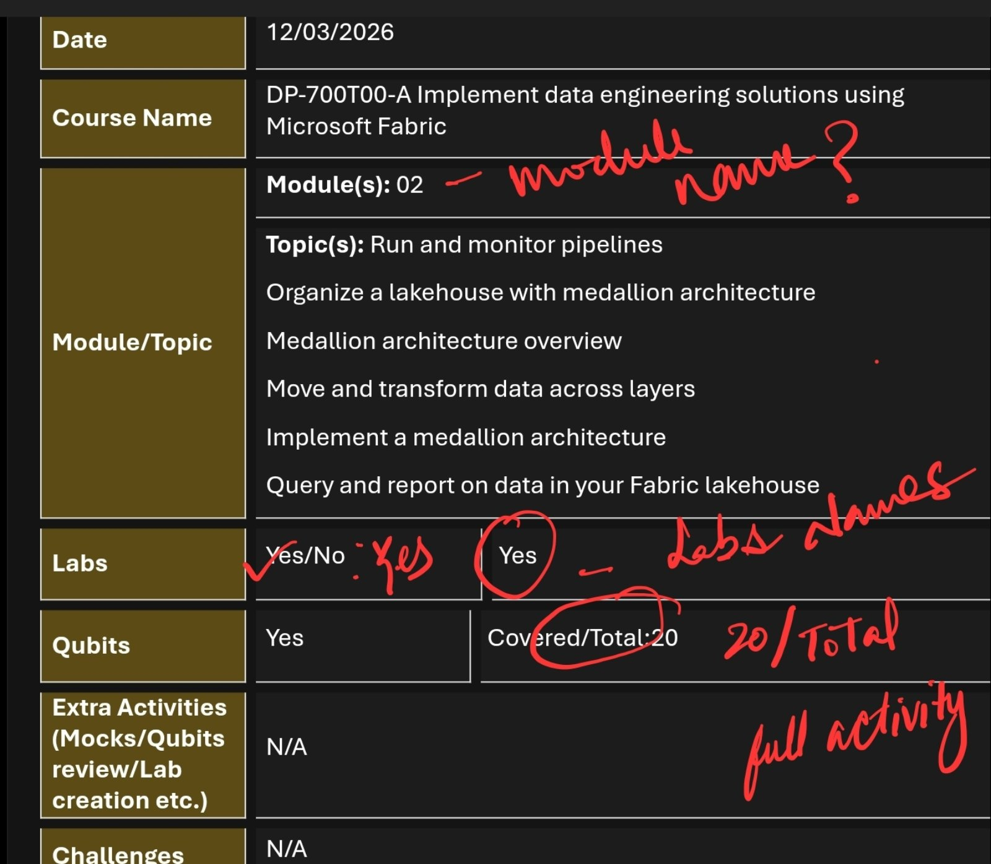
DSR
Notes:
Let’s talk about Daily Status Reports for a moment. Many teams treat DSRs as routine administrative tasks, but in reality they are one of the most valuable reflection tools for a trainer. When you write a DSR honestly, you capture what was learned, what preparation happened, what challenges appeared, and what still needs attention. Over time those reports create a timeline of growth. They help managers understand where support is needed and help trainers see how their preparation habits evolve. The key expectation here is accuracy. The report should reflect real effort and real challenges, not just generic statements. When DSRs are written with honesty and clarity, they become extremely useful for both accountability and mentorship.

Slide 25
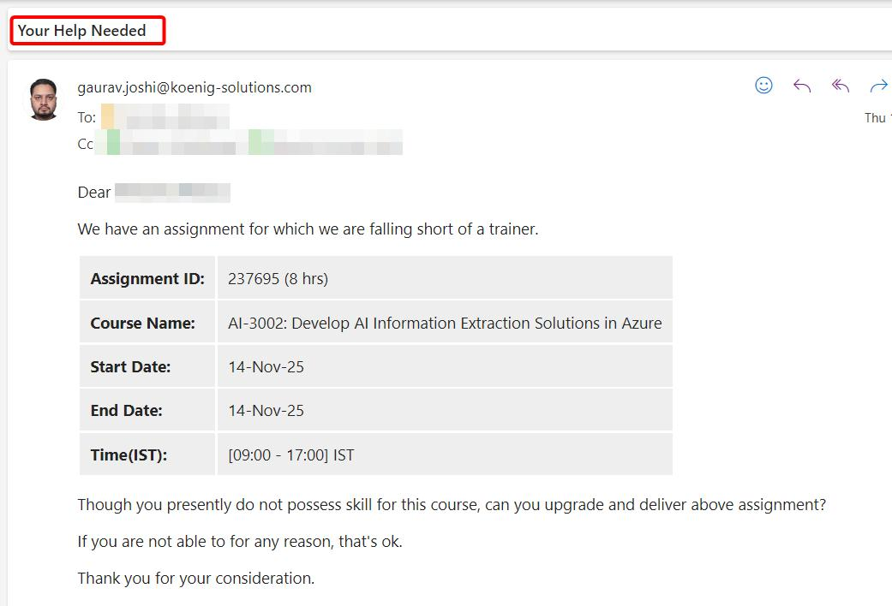
Help Needed Emails
Notes:
Let me share something that experienced trainers eventually realize. The biggest delays in projects rarely come from lack of ability; they come from late communication of problems. When someone faces a difficulty but waits too long before raising it, the solution window becomes smaller. That’s why asking for help early is actually a professional strength. Whether the challenge is conceptual understanding, lab setup, environment issues, or delivery preparation — communicating early allows the team to solve the problem together. Think of it like navigation during a long drive. If you realize you took a wrong turn but keep driving silently, the correction becomes harder. But if you check the map immediately, the adjustment is quick and easy.

Slide 26
Let’s Begin...
Skill
Sync
Notes:
Let me close the huddle with one simple reflection. Great trainers are not created overnight. They are built through consistent preparation, honest feedback, and disciplined execution. Over the coming weeks our focus will remain very clear. Stabilize mock outcomes. Strengthen concept clarity. Improve communication maturity. And maintain visible execution through certifications and webinars. When these pieces align, the team naturally moves from preparation mode to confident delivery mode. And that is the direction we are moving toward together. So let’s take the insights from today’s discussion and start executing the next phase with clarity and focus. Alright — let’s begin.

